Slide 1
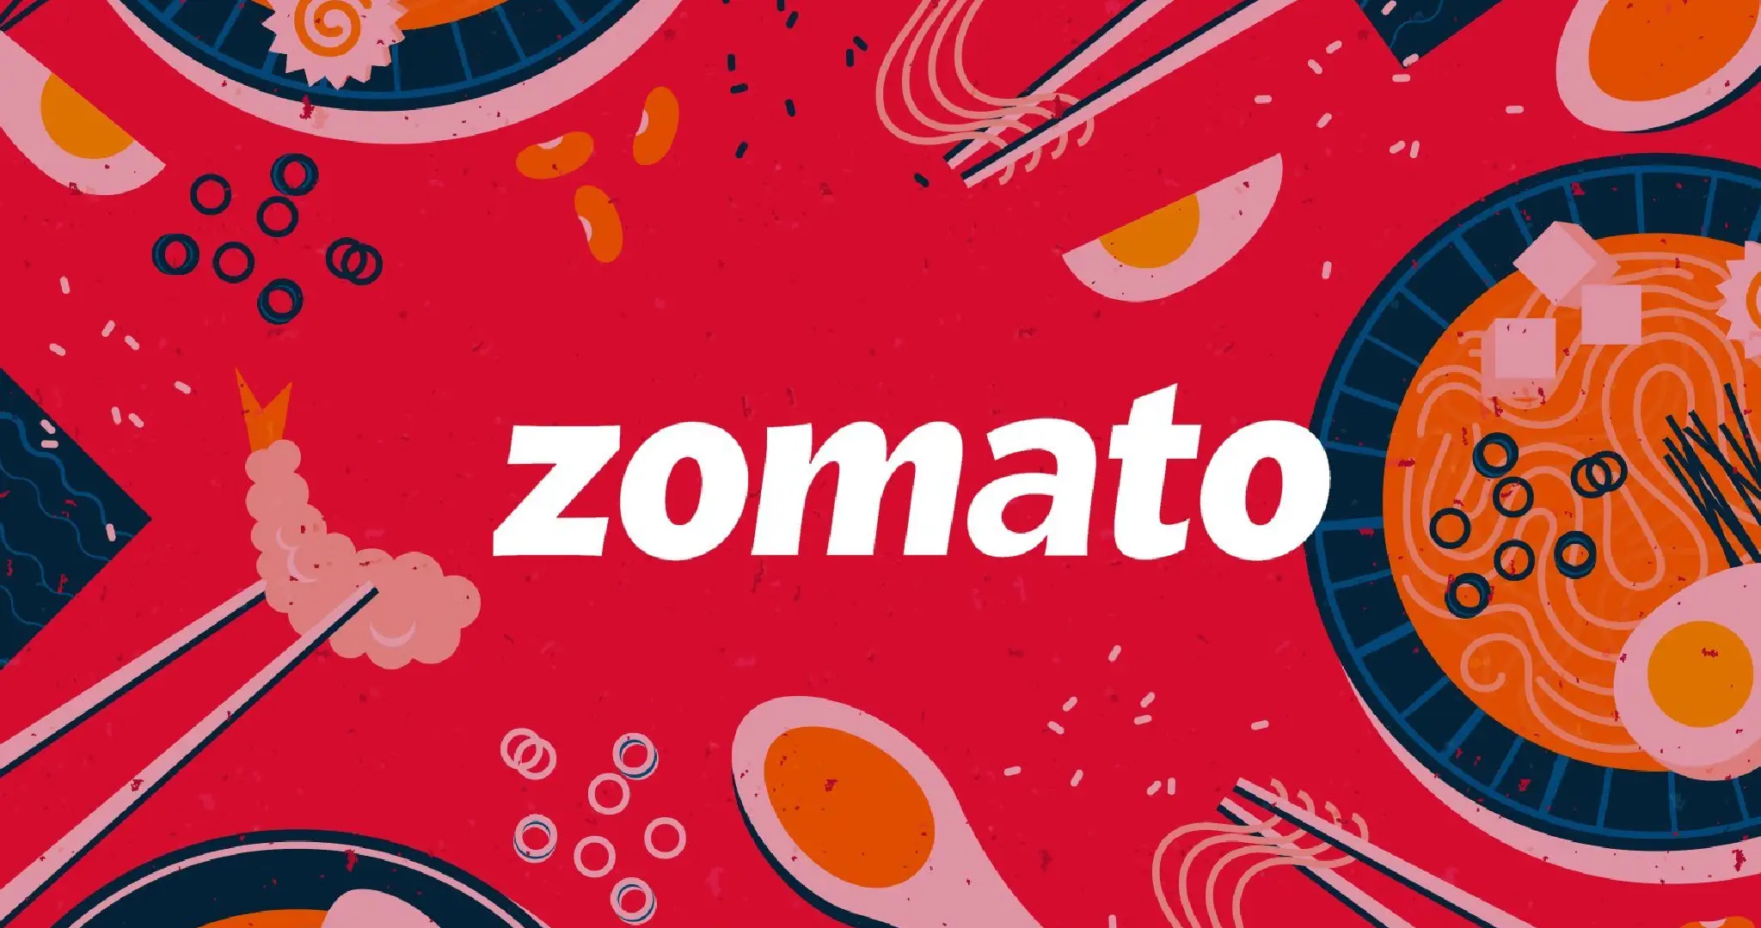

Slide 2


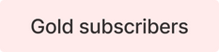




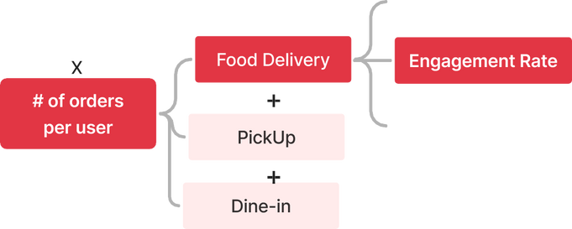





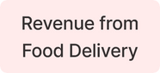


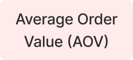


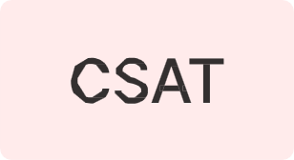
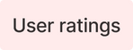


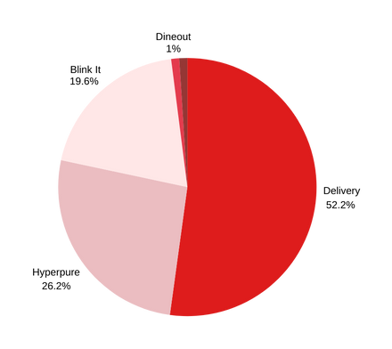














ZOMATO’S OVERVIEW
Started
Operations
Zomato, founded by Deepinder Goyal and Pankaj Chaddah in 2008, is a global restaurant aggregator and food delivery company. Initially launched as FoodieBay, Zomato has grown into a multinational platform, offering services across borders and through diverse subsidiaries. With a mission to deliver the best food options tailored to local preferences, Zomato continues to innovate and expand its reach, redefining the food delivery and dining experience worldwide.
First Fund
Raise
Market Leadership
58% market share with 85M MAU and INR 590 average order value.
Present in 3,500+ cities, hosting 1.5M restaurants and 23,000 partners.
Financial Highlights
Revenue: INR 8,500 Cr, Net Profit: INR 350 Cr.
Growth driven by user engagement and high-margin services like Hyperpure and Blinkit.
Strategic Priorities
Expand into tier-2 and tier-3 cities.
Enhance delivery efficiency and partner collaboration.
Focus on sustainability and high-margin revenue streams.
Entered into
Delivery
Launched
Zomato Gold
Expanded to
UAE & Indonesia
Defining the Problem:
Integrate Guwahati's street food vendors into Zomato’s platform by addressing onboarding, operational challenges, customer engagement, and quality assurance. The goal is to preserve authenticity and affordability while expanding access and showcasing Guwahati’s culinary diversity.
Mapping the business outcome of integrating Guwahati’s street food vendors into Zomato’s platform, we identify 3 key KPIs to focus on:
Launched
HyperPure
Approximately 52.2% of the revenue for Zomato comes from its food delivery buisness
Acquired
Uber Eats
Order Quality and Feedback
Customer Engagement Rate
Vendor Onboarding Rate
Integrating Guwahati’s street food into Zomato can expand vendor reach, improve livelihoods, and provide customers easy access to authentic local delicacies. This initiative aligns with Zomato’s mission to offer the best food options in every community while celebrating regional diversity.
Launched
IPO
To Turn Profitable, It is important to maximise the revenue while minimising the costs, in this sector
Achieved Profitability for the first time

Slide 3
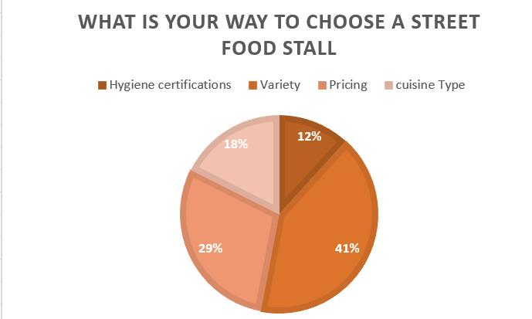


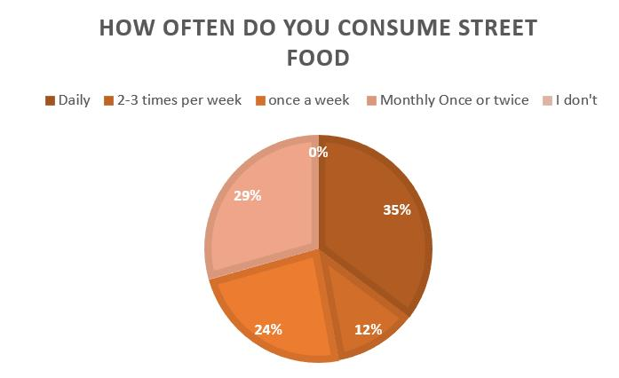
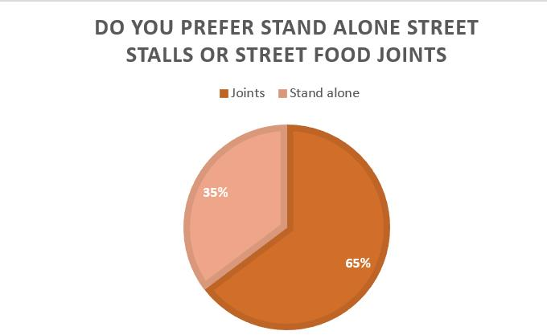

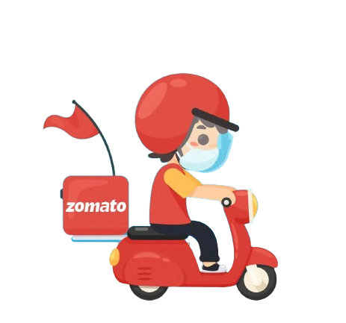




PRODUCT METRICS UNDER CONSIDERATION
SURVEY INSIGHTS
CUSTOMER METRICS
VENDOR METRICS
Recurrence rate of street orders
Monthly cost savings
Delivery time
Excellent orders
Number of stalls tried monthly
Number of street credits generated
No. of extra Zomato orders(slips)
New stall users/customers
Growth in offline customers
Extra revenue generated
Branding extent and growth
Average delivery turnover
ZOMATO METRICS
DELIVERY PARTNER METRICS
CSAT score
UAT score
Revenue generated for the platform from new feature
Monthly active feature users
Cost of customer feature acquisition
Total revenue generated from feature
Number of street deliveries completed
Extra Money collected by street deliveries
Average street delivery time
Correct and proper orders delivered
Total completed deliveries monthly
Bonus received

Slide 4


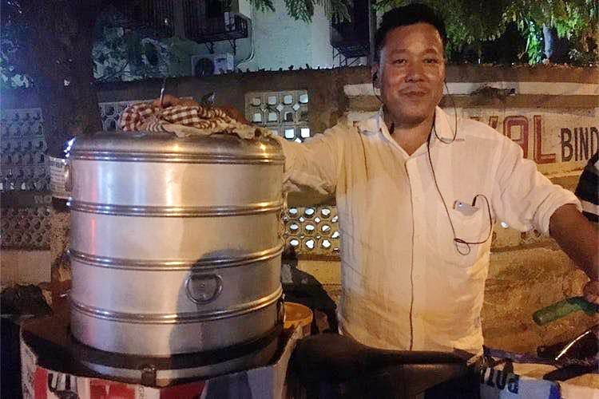

UNDERSTANDING OUR TARGET PERSONA THROUGH USER PERSONA
Name: Priya
Age: 34
Location: Guwahati
Name: Manab
Age: 27
Location:
Guwahati
Name:Raju
Age:42
Location:
Guwuhati
Name: Nikhil
Age: 22
Location: IIT Guwahati
Campus
Background:
Raju is a seasoned street food vendor who has been running a popular momo stall in a bustling market area for over 15 years. Each day, Raju starts his morning by preparing fresh fillings and dough, often experimenting with new flavors to keep his menu exciting. Over the years, he has built a loyal customer base of office-goers, students, and tourists who admire his consistent quality and friendly service. Despite his stall’s popularity, Raju’s income is unpredictable and largely dependent on weather conditions and foot traffic. With limited resources and no formal exposure to technology, he finds it challenging to expand his business or adopt modern practices..
Background:
Nikhil is a final-year engineering student at IIT Guwahati who juggles a hectic schedule of classes, project deadlines, and campus activities. Late-night study sessions and group discussions are often fueled by cravings for street food, which Nikhil and his friends enjoy during occasional trips to the city. However, frequent trips outside campus are not always feasible due to academic pressure and time constraints. Nikhil values affordability, convenience, and variety in food options, and he wishes there were a reliable way to enjoy Guwahati’s street food without leaving campus. While he uses food delivery apps regularly, he finds that the authentic taste of local delicacies is often missing.
Background:
Priya is a homemaker with two school-going children and a husband working in a government office. She takes pride in organizing family get-togethers and introducing her family to diverse culinary experiences. Priya enjoys exploring the rich variety of street food in Guwahati but finds it challenging to bring those flavors home for family dinners due to hygiene concerns and limited accessibility. She values quality, affordability, and convenience, especially when entertaining guests or providing her children with a treat after school. Priya is keen on finding reliable platforms that can bridge the gap between her family’s love for street food and their health and safety needs.
Background:
Manab is a young marketing professional working for a reputed firm in Guwahati. His weekdays are packed with client meetings, tight deadlines, and a long commute, leaving him little time to explore the city’s street food scene. However, during weekends, he loves visiting popular local stalls with friends to indulge in authentic street food delicacies. Manab often finds himself craving these flavors during the workweek but struggles to access them conveniently due to time constraints.
.
Pain Points:
Limited access to local street food vendors through online platforms.
Concerns over food quality and hygiene when ordering street food.
Lack of variety and authenticity in packaged alternatives.
Pain Points:
Limited customer reach due to lack of digital presence.
Difficulty in managing high demand during peak hours.
Concerns about maintaining food quality and hygiene standards for delivery.
Pain Points:
Limited access to authentic street food within the IIT campus.
Inconvenience of traveling to the city for food during busy schedules.
High prices of alternatives that lack the taste and authenticity of local street food.
Pain Points:
Lack of trusted online platforms offering authentic street food.
Difficulty in ensuring hygiene and consistent taste for family meals.
Limited awareness of street food varieties available in Guwahati.
Expectations:
A simple onboarding process to list his stall on an online platform.
Support for packaging and delivery logistics to maintain food quality.
Increased income through access to a broader customer base.
Training and resources to adapt to digital operations without disrupting his workflow.
Expectations:
A platform that delivers hygienic, authentic street food.
Reliable information on local food options and variety.
Affordable delivery charges suitable for frequent orders.
Expectations:
Seamless online access to Guwahati’s authentic street food options.
Assurance of food quality, hygiene, and authenticity.
Affordable pricing without compromising taste and cultural essence.
Expectations:
Availability of authentic Guwahati street food on online delivery platforms.
Affordable pricing suitable for a student’s budget.
Quick and reliable delivery services to the IIT campus.

Slide 5






UNDERSTANDING THE PROBLEM OF OUR TARGET
How do we know it is a real problem?
Research indicates a significant demand for authentic street food options in Guwahati.
Surveys reveal customer concerns about hygiene and convenience when accessing local food.
Interviews with street food vendors highlight operational and logistical challenges.
What is the value generated by solving this problem?
For Users:
Easy access to Guwahati’s vibrant street food, maintaining authenticity & hygiene.
Enhanced dining experiences with affordable and convenient options.
For Vendors:
Increased visibility and revenue opportunities through Zomato’s platform.
Support in maintaining food quality and scaling operations.
For Zomato:
A competitive edge by diversifying offerings & showcasing Guwahati’s street food culture.
Improved customer retention and engagement.
What is the true problem?
Limited digital accessibility for local street food vendors.
Hygiene and quality concerns for customers.
Challenges in scaling traditional street food operations to meet online demand.
Why should we solve the problem now?
The rapid growth of India’s food delivery market creates an opportunity to include underserved vendors.
Capturing this demand can drive profitability while preserving local food culture.
Key Objective
Vendor Onboarding: Develop a seamless onboarding process that accommodates small-scale vendors with minimal technical know-how and financial constraints.
Operational Challenges: Address logistical issues such as packaging, delivery, and maintaining food quality during transit.
Customer Engagement: Create strategies to engage customers while highlighting the unique aspects of Guwahati’s street food.
Quality Assurance: Implement mechanisms to ensure food safety, hygiene, and consistent quality without compromising authenticity.
Sustainability: Establish a sustainable business model that aligns with the affordability of street food and supports the livelihoods of vendors.
Who is facing the problem?
Street food vendors lacking the means to access a broader market.
Urban customers seeking authentic food options
Hygienic street food options.
Zomato, aiming to integrate local street food vendors sustainably

Slide 6










SOLUTION AT A GLANCE
ZOMATO ZONES
COUPON TICKETING SYSTEM
CSR FULLFILLMENT
Zomato’s coupon ticketing system in street food zones streamlines order management by issuing unique coupons for tracking and collection. Vendors fulfill orders sequentially, reducing delays and chaos during busy hours. This ensures efficient service, benefiting vendors, customers, and Zomato alike.
Creation of Zomato zones, a one of a kind solution to the hustling street stall business being integrated ion the platform. Opening of Zomato zones around high street food stall density localities in the city of Guwahati. Creating a check and balance system as well as helping in the easy management of the orders
Formulating helping drives to uplift the lifestyle of the street vendors and spending the CSR fund on the Upliftment of this section of society. Money can be spent on Education, lifestyle and healthcare of the food seller, taking care of growth in the hygiene and standards as well as usage of the CSR budget
SANITARY KITS
STREET CREDIT SYSTEM
COMBOS (ML INTEGRATION)
One major issue with street food in today’s time is the apprehensive nature of the consumers due to the quality and the hygiene practices which are to be followed. Our company to solve this issue will provide sanitary kits on regular intervals to these vendors on a subsidized rate ensuring safety.
The reward system of the company, where the numbers and the price/quantity of the order placed will determine the loyalty of the users the street food. Can be interchanged to buy other products currently collaborating with Zomato there or redeem the points to get excellent discounts on your favorite street food items.
What else better than a plate of pani puri combined with a steaming hot plate of chole bhature. Now order Items in combos based on the street or locality that you choose. The ML algorithm learns and creates interesting combos curated just for you based on the choices that the street has to offer.

Slide 7









A DEEP DIVE INTO SOLUTIONS
DETAILED SOLUTION
PROBLEMS
SOLUTIONS
We have developed a comprehensive solution to manage the grievances of both customers and vendors. The platform features a dedicated section for streets and localities in Guwahati.
Users place orders based on their mood, and the order is received by the Zomato employee in the respective zone, who generates a ticket or coupon with the order details and any specifications. The assigned delivery partner then reaches the designated locality or street to collect the coupon from the Zomato zone by providing a system-generated OTP. The delivery partner then takes the coupon to the vendor and places the order offline, just like a regular customer. Upon receiving the order, the delivery partner pays the required amount (food and packaging costs) to the vendor, collects the packaged food, and proceeds to the delivery location. This system ensures trust between the vendors and the platform, allowing stall owners to manage deliveries effectively. It also addresses issues like large order volumes and packaging quality. Additionally, the zones facilitate the offline onboarding of vendors.
Lack of knowledge
Educational and skill issues faced by the owners of the street stalls, causing them unable to use the platform efficiently.
Zomato zones
Creation of zones in the streets having many street food vendors and addressing the orders on their behalf.
Order management
High order volume at peak times causing the mismanagement, wrong orders being given out due to low workforce.
Coupon ticketing system
The riders allotted the order will collect coupons for the same from the Zomato zone and will primarily act as a customer at the stall and hand out the coupon, collecting the order
Online-Offline handling
Due to lack of knowledge and low workforce the orders handling for the vendors becomes tough, simultaneously handling the two ways to serve is difficult.
Delivery boy → Customer
When a delivery boy acts as a offline customer the vendor needs to worry only about the offline flow of orders, ensuring better management and greater efficiency
VALUE GENERATION FOR THE STAKEHOLDERS
CUSTOMERS Your favorite street food, now on your plate: Getting the lip smacking local street food with the comfort of your home at minimal rates. Affordability: Month end, saving for that big year end holiday? Zomato is here to serve you with the best street delicacies at affordable prices. Variety: Tired of the sedentary food eating habits. Worry not, here is the whole street food selection at the touch of a button | DELIVERY PARTNERS Guaranteed orders=higher earnings: More orders mean increased earnings for the delivery drivers Order batching: The riders can save fuel and money. Order batching from a single street due to multiple vendors being available. Stable income: Advance knowledge of weekly orders ensures a steady income for the riders. | STREET VENDORS More customers:- Increasing the TAM for the vendors will surely increase the revenue streams. The rapid growth in the industry helps too. Better Hygiene standards: Quality checks on a regular basis and surprise audits will increase the vendors to get better hygiene solutions increasing leverage. Branding: Making your street cart go more main stream helping you cater a larger audience and increase reach | ZOMATO Integration of hyper pure : Hyper pure can be integrated into this system to ensure quality and hygiene and increasing revenue and control. Feature inclusion: addition of a new feature ensuring a major problem being solved helping to increase the customers. CSR: Spending in the development of these streets and helping the vendors out in matters of health and education

Slide 8





INTO SOLUTIONS
CHAIN OF EVENTS
Customer uses platform to place order from a particular locality/street
Delivery partner is assigened and the order details are sent to the respective ZZ
The coupon is generated by the Zomato zones operator and the order details fed in the database
The assigned delivery partner collects the token/coupon from the ZZ by providing a system generated OTP.
The delivery partner then essentially becomes the customer for the stall, hence only one type of customer(offline) needs to be entertained.
The money is credited to the delivery partners account through backend and payment is made real time to the vendor
The delivery is made asap and voila! Best of the street food on your plate just by the clicks of a few buttons
The order is picked and the database is then updated suggesting the ETA of the delivery driver.
The order is placed and prepared by vendor. The Zomato delivery partner makes sure of the packaging ad hygiene.
MINOR CHALLENGES AND THEIR SOLUTIONS
SOURCES OF REVENUE
Challenge: The concern of quality and hygiene being delivered to the customers
Mitigation: Fostering a system of random auditing where the Zomato zones employees can take rounds taking notes of the inventory, hygiene and packaging.
Challenge: Concern regarding the payments system for the vendors
Mitigation: Making a system where the Zomato zones in the locality will be credited with the menu price of the order. The vendors can get bi-weekly(so that they don’t face issues on a day-to-day basis) payments into their ban account.
Challenge: How will Zomato ensure hygiene being regularized?
Mitigation: Providing sanitary kits to the stalls paying a minimal fee(gets Zomato assured status on app) ensure all round hygiene.(contains hairnets, gloves, cleaning cloth etc…) and running awareness campaigns and hygiene drives to promote habits that help in this matter.
Challenge: Maintaining delivery time efficiency (especially during peak hours)
Mitigation: Street food requires minimal preparation time, and stationing riders at Zomato Zones near food hubs can reduce the average 7.3-minute rider allocation time. Batch order collection during peak hours and incentives like bonuses and ratings will further streamline deliveries and enhance efficiency
CUSTOMERS
VENDORS
BRANDS PROMOTED
Delivery charges applied as per the distance . Completely credited to the delivery partners.
A minimal platform fee is paid by the customers on every order(₹ 10). We propose to increase this to ₹ 12(to pitch in for hygiene kits), without hiking the menu prices of the food.
Zomato Gold Special offers for the street food fiestas in order to cure the hunger with mouth watering delicacies
To ensure the hygiene and safety of the street food being served, we propose provision of biweekly collection of hygiene kits(containing hairnets, gloves, cleaning cloth etc..). The vendors in order to procure the kits will have to pay a minimal amount
Zomato’s new feature-Street credit points can be redeemed on select brand items or on other street food orders only(discounts and flash deals). This branding of the goods helps to generate commission

Slide 9
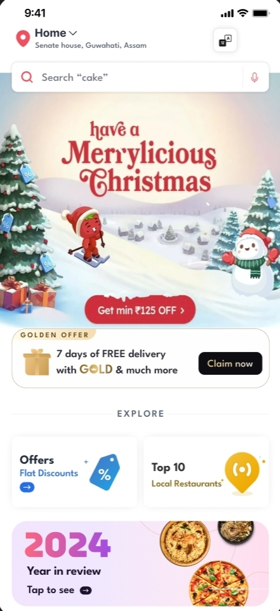
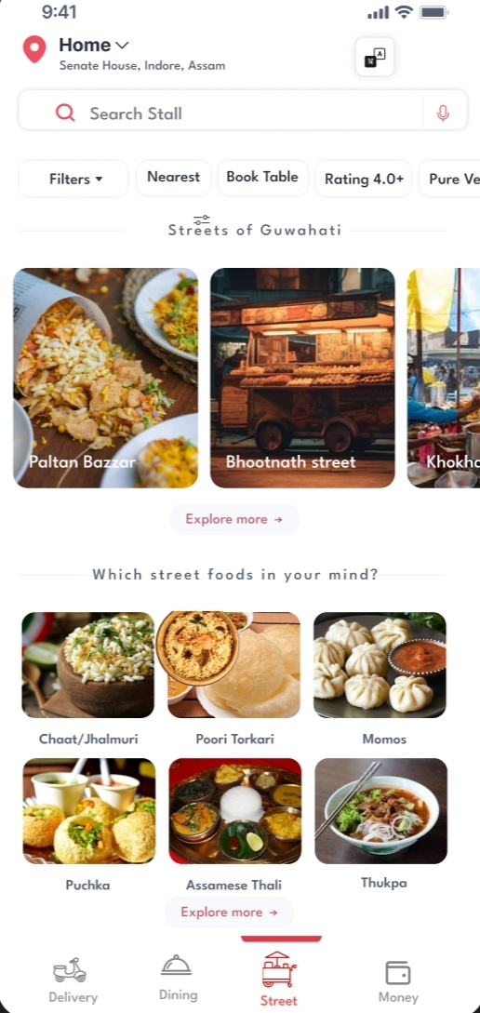
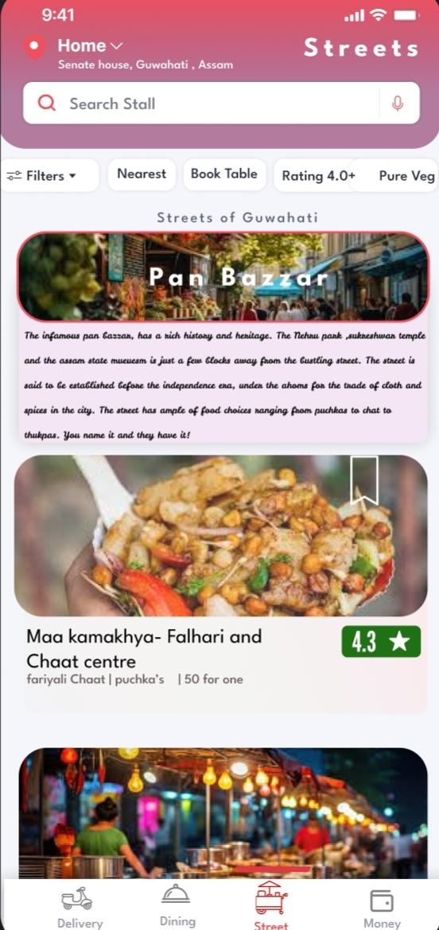
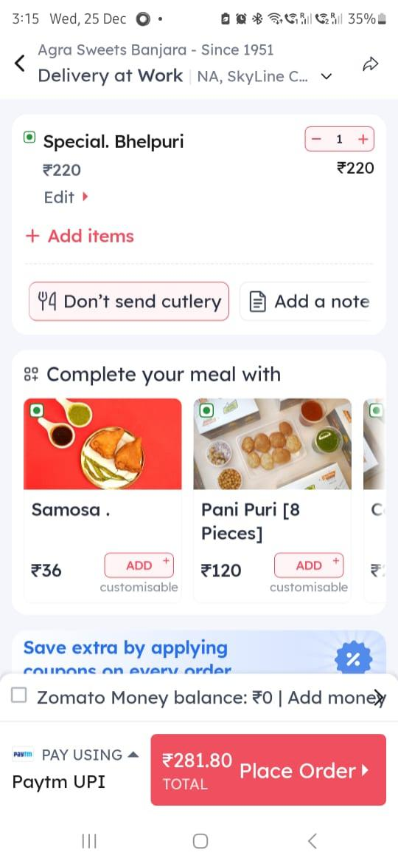




WIREFRAMING AND DESIGNING THE FRONTEND FLOW FOR CUSTOMERS
The customer lands on the main page and navigates to the street food menu by tapping the button at the bottom.
Choosing the street or locality to order from, with the option to filter by specific street food items.
Selecting the stall/vendor and the desired food items for the order.
Reviewing the order, applying coupons, and completing the payment at checkout.
Choose from multiple localities and streets
Street Tales-one of the delighters on the platform to increase the Average time spent on the application metric
Order based on the street food you would like to try.

Slide 10
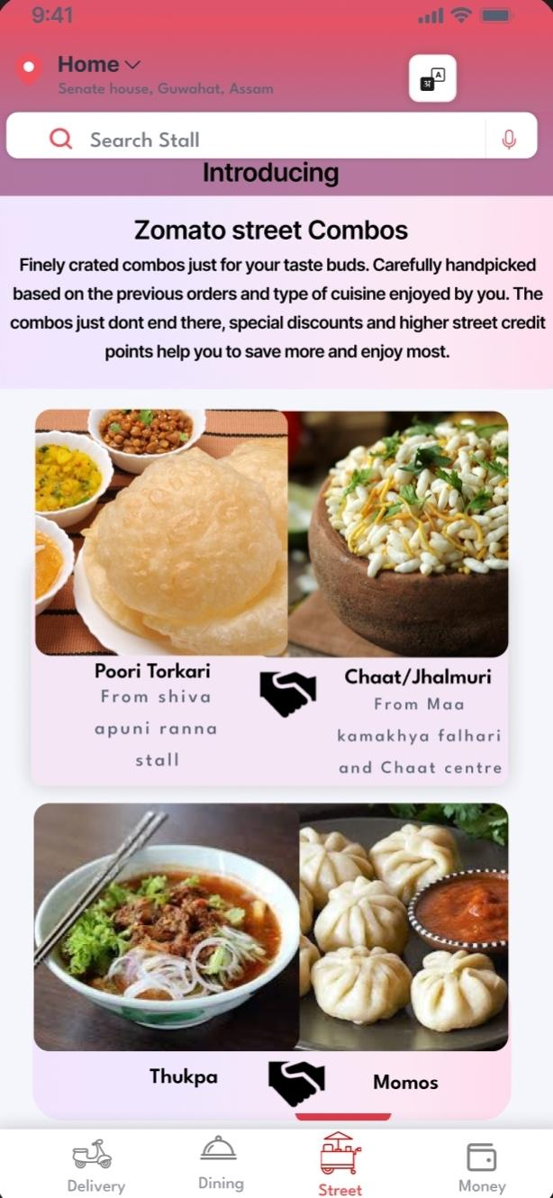


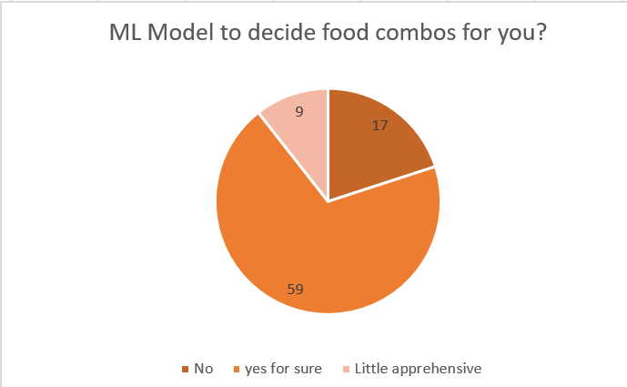
A DEEP DIVE INTO SOLUTIONS
KANO MODEL APPLIED OVER SOLUTION 1
ML INTEGRATION TO PREDICT COMBINATIONS
Satisfaction
Performers
The Localities or streets where the zomato zones will be created will be taken after consideration of the variety of food options, the number of stalls and the footfall in the region. Based on these parameters we came up with 5 zones in Guwahati.
The best part of going to these streets is the variety that one can experiment with and we provide the perfect solution to you.
The ML algorithm implemented to the system will curate lip smacking combos for you in real time, based on the locality that you have picked. Be it the past orders choices or the taste combos that you prefer the ML will work its magic to form the combos for you.
Ordering the combos benefits the users as well, providing spontaneous discounts on these combos as part of the offer.
Delighters
Functionality
Our solution- (Between the delighters and performers)
Getting your favorite street food items, with guaranteed timely delivery, assured hygiene and sealed packaging. What could be more delighting than this. The implementation will cause the delight factor to increase and hence with little efforts and money we can land between the delighters and the performers.
Our solution
Must
haves
SUCCESS MATRIX
STREET TALES
Monthly active street food feature users
Recurring user rate
Customer platform usage cost
Number of orders(Daily)
Time spent on feature
Time to first value
A minor solution which is a delighter feature increasing the engagement of the users. Sharing the tales of the streets. The past the present and how the future will shape out to be will surely of interest for the customers. As for Guwahati, the streets have stories engraved on them and to share this to ignite the inner foodie would be the cherry on top. This will increase the interest of the users to try the street food and hopefully continue with their choice
Form Results

Slide 11




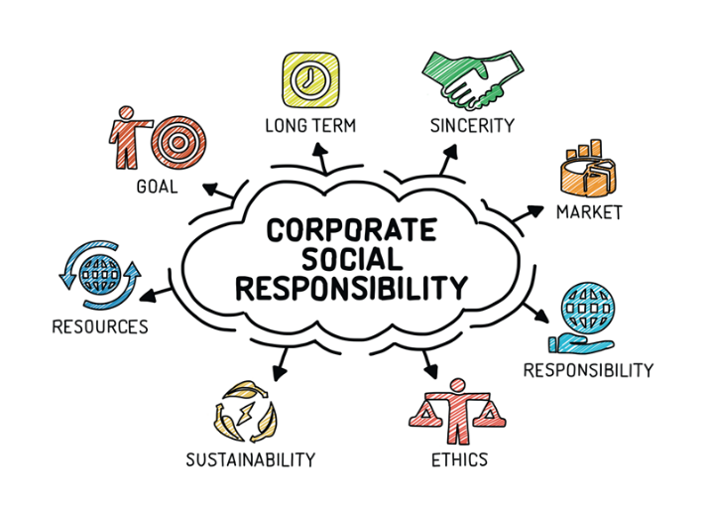




STREET CREDIT SYSTEM
SANITATION KITS
CORPORATE SOCIAL RESPONSIBILITY
Like the zomato rewards system but will be exclusively for the orders being placed for the street food offerings.
The street credit will be separately stored based on the amount, the frequency and the total price of the can be redeemed from the street wallet to avail discounts on the street food items and combos exclusively or the brands that zomato has collaborated with.
The street credits will hold more credit to currency ratio initially compared with the initial reward system of zomato in order to increase the users of this feature.
The current coins to currency ratio for Zomato is 0.9INR, but for the street credit points the initial credit ratio will be 1 INR.
This system of higher credit to currency ratio will be revoked once the UAT for the feature is completed and the ratio for both the credit systems would be made equal.
Hygiene is the question while trying out street food and always a cause of worry for the customers. The indigenous solution to this problem is to provide sanitation kits to the vendors at a regular interval of time.
The sanitation kit would contain Items like hairnets, gloves, cleaning clothes, sanitizer, mask, visor etc…. to meet the requirements of todays hygiene standards.
The Kits would be distributed on a paid service basis where half the cost of the kits would be taken in from the higher platform fee (2 INR) per order. The other half is a subscription system taken up by the vendors. In return of the subscription of the kit the platform on the application would reflect assured safety from zomato causing a higher chance to place an order from that particular stall.
For the initial 6 months after the onboarding the kits will be free after which they will be monthly subscription .
Corporate social responsibility is a mandatory activity and this solution proposes the use of the CSR fund(collected form the different profitable arenas) to be spent on the upliftment of the families of the vendors and for the transformation of the streets.
The CSR fund to be spent can be utilized for the education, health and the sanitation of these vendors. The fund can also be spent on educational drives to educate the families about public and personal health and hygiene.
Cleaning drives in these localities and streets will also achieve higher rewards for the vendors. Transforming the streets can have a positive effect on the business aligning with the swatch Bharat abhiyaan of government of India

Slide 12





PRIORITISATION MATRIX
FEATURE | REACH | IMPACT | CONFIDENCE | EFFORTS | RICE SCORE
CSR | 8 | 7 | 8 | 5 | 7.2
HYPER PURE INTEGRATION | 6 | 6 | 7 | 8 | 4.5
ML TO FORM COMBINATION | 9 | 8 | 8 | 6 | 8.0
STRRET CREDIT POINTS | 8 | 8 | 8 | 6 | 7.5
ZOMATO ZONES | 9 | 9 | 9 | 7 | 8.4
SANITARY KIT | 7 | 8 | 8 | 6 | 7.5

Slide 13














GTM EXECUTION PLAN
Phase I:
Awareness Phase:
Creating Excitement
Phase II:
Early Adoption Phase:
Testing and Refinement
Phase III:
Launch Phase:
Scaling Adoption
Phase IV:
Sustained Engagement Phase:
Driving Retention
Pre-Launch Buzz
Use in-app banners and push notifications teasing the relaunch: “Something delicious is coming!”
Roll out teaser campaigns on social media with hashtags like #localfoodbestfood.
Partner with influencers and food bloggers.
Pilot Launch
Roll out Zomato Street Smart in selected areas first (like Pan Bazaar etc.) to test it.
Partner with top restaurants and delivery providers in these regions for exclusive perks.
Exclusive Perks
Launch Street credits events like food festivals or dining experiences with celebrity chefs.
Partner with popular brands for co-branded offers (e.g., discounts on Uber rides to restaurants).
Grand Launch Campaign
Announce Zomato Street Smart through a large-scale campaign featuring celebrities or influencers.
Use a mix of TV, digital ads, and social media to promote benefits like “Free deliveries and up to 40% off on first order!”.
Feedback Collection
Use a feedback loop from early adopters to refine the program.
Offer trial subscriptions to high-value users to build momentum.
Personalized Communication
Use customer data to recommend street food dishes tailored to their preferences.
Notify members in real-time to reinforce the value of the Zomato user.
Customer Surveys and Engagement
Conduct surveys to gather feedback on the most desirable food type.
Create a referral-based waitlist for early access to generate exclusivity and FOMO.
Localized Offers
Customize offers for Tier 1 and Tier 2 cities to maximize relevance (e.g., dining discounts in Tier 1, delivery offers in Tier 2). ​
Partner Collaboration
Incentivize partner shops with increased visibility and customer buying during the trial phase.
Feedback and Iteration
Regularly survey members for improvement suggestions.

Slide 14



IMPLEMENTATION
BUDGET ALLOCATION
Medium Effort ⬄ High Impact
Implementing Zomato Zones
will help in efficient and fast
management of street food
delivery system. It will help in avoiding confusion and discomfort.
High Effort ⬄ High Impact
Implementing coupon system
will help in efficient and fast
management of bills and money related things as no of coupons will determine payment to our partner.
Medium Effort ⬄ Medium Impact
Offering Combos will increase revenue, serve people’s taste and increase engagement with partners and customers.
It will help in giving more options to users.
Marketing and Promotions: 50% Digital ads, influencer partnerships, and in-app campaigns
Partner Incentives: 25% Subsidized discounts for street shops partners during the launch phase.
Technology and Support: 15% Enhancing the app interface for seamless integration of benefits.
Customer Success: 10% Dedicated teams for onboarding and assisting partners.
COMBOS (ML INTEGRATION)
ZOMATO ZONES
COUPON TICKETING SYSTEM
SANITARY KITS
STREET CREDIT SYSTEM
CSR FULLFILLMENT
High Effort ⬄ Low Impact
Although, a cost increasing idea but it has a long term impact as people value hygiene over anything else.
It will help improve overall Zomato’s reputation.
Low Effort ⬄ High Impact
We will provide extra benefits based on Street Credits which will decrease churn rate and increase monthly visits and no of orders.
Collaborating with other brand can also help giving some extraordinary benefits.
Low Effort ⬄ Low Impact
Not a very great way to improve user engagement and retention. But can help in government fulfilment and appealing to users for noble cause.
Expected Results
Rapid adoption of Zomato Street Food Facility.
Higher order frequency and ordering of street food through Zomato.
Improved partner satisfaction and retention through increased traffic and visibility.

Slide 15
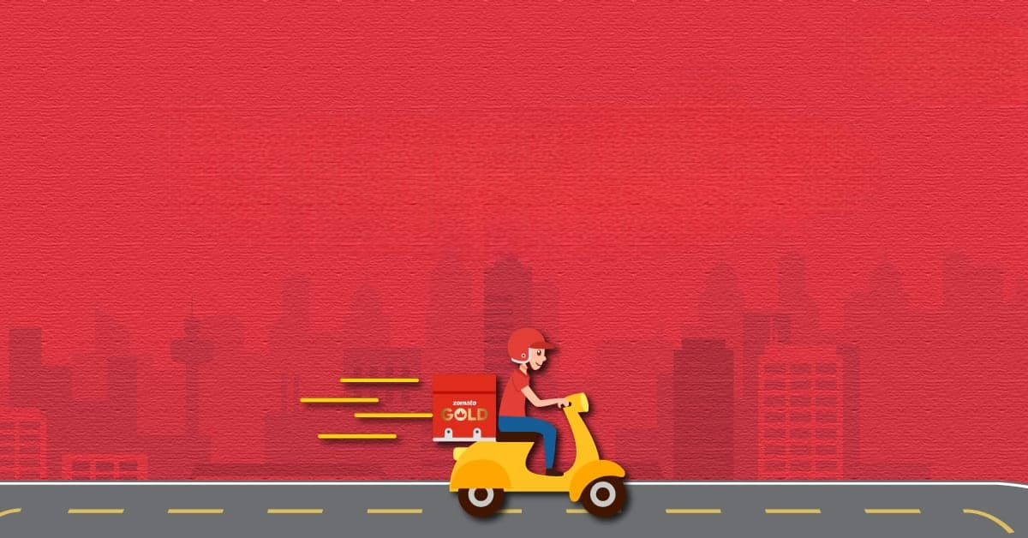
THANK YOU
TEAM- SRGK

